Slide 1

INTERNET OF THINGS
Introduction
Dr. Nagegowda K S
Department of Computer Science & Engineering

Slide 2

INTERNET OF THINGS
Introduction to IoT
Chapter1: What is IoT?
Dr. Nagegowda K S
Department of Computer Science & Engineering

Slide 3
INTERNET OF THINGS
What is IOT?
Internetworking of
Physical devices, vehicles, buildings and other items
Devices are embedded with electronics, software, sensors, actuators, and network connectivity
Objectives
Enable these objects to collect and exchange data
Use data collected by devices for providing services and in decision making
Global infrastructure for the information society

Slide 4
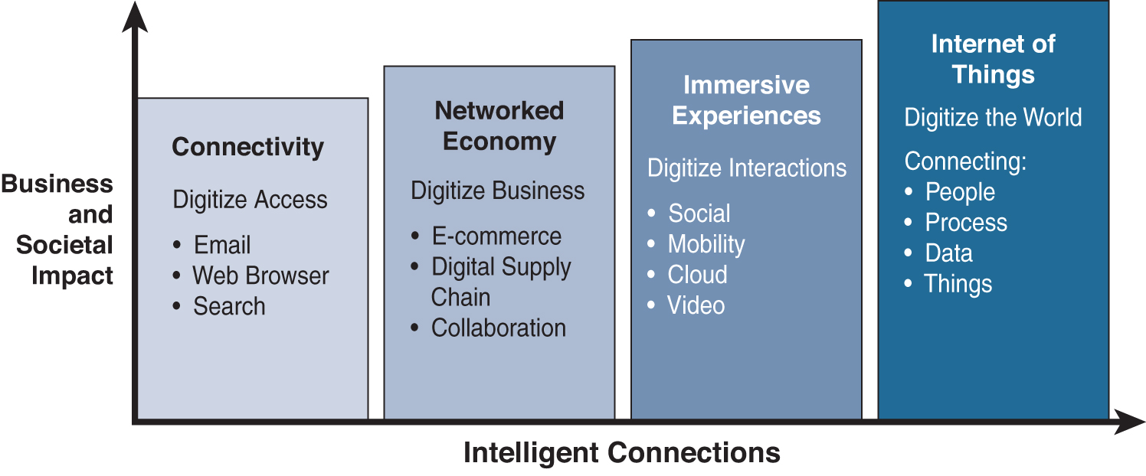
INTERNET OF THINGS
Evolution of IoT
Figure - Evolutionary Phases of the Internet

Slide 5
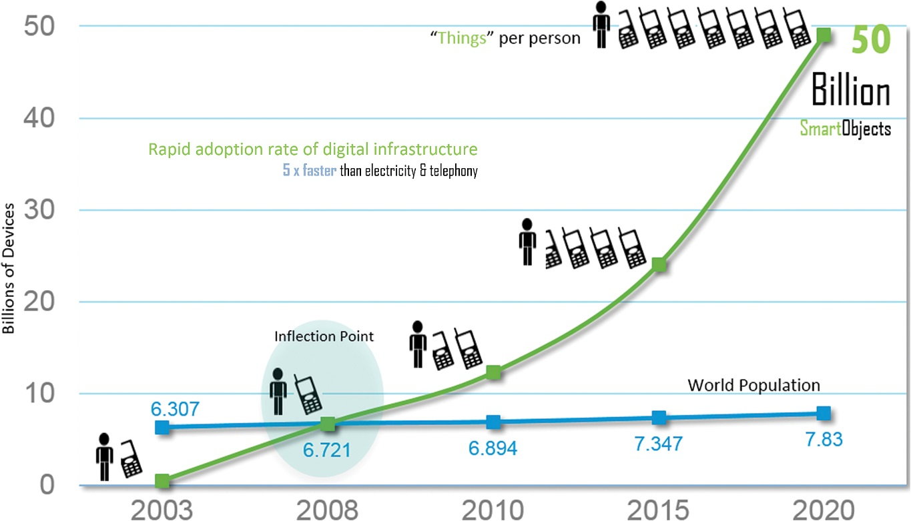
IoT Impact
INTERNET OF THINGS
Figure - The Rapid Growth in the Number of Devices Connected to the Internet

Slide 6
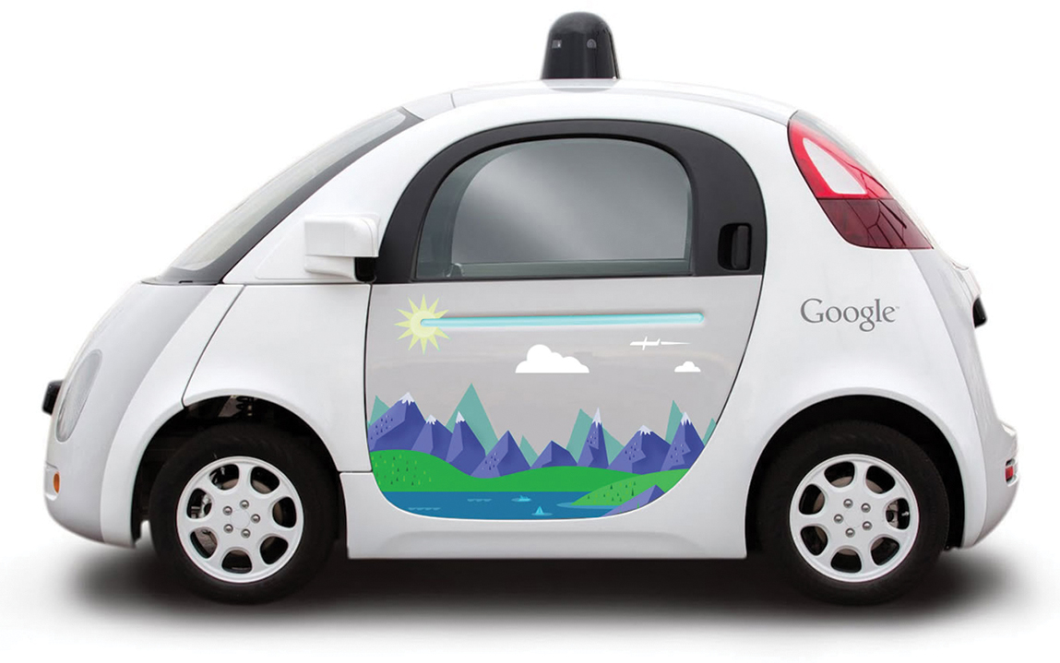
INTERNET OF THINGS
Connected Roadways Challenges
Safety
Mobility
Environment
Figure - Google’s Self-Driving Car

Slide 7
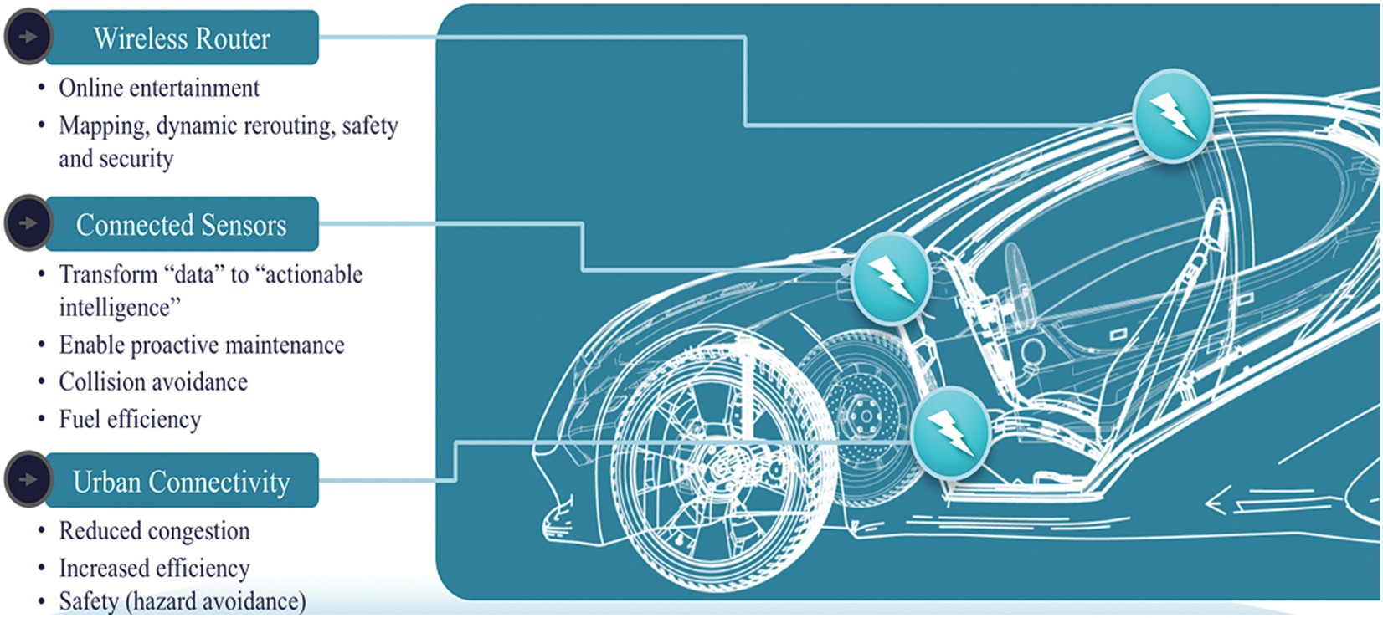
INTERNET OF THINGS
Figure - The Connected Car

Slide 8
Connected Factory
INTERNET OF THINGS
The main challenges facing manufacturing in a factory environment today include the following:
Accelerating new product and service introductions to meet customer and
market opportunities
Increasing plant production, quality, and uptime while decreasing cost
Mitigating unplanned downtime (which wastes, on average, at least 5% of
production)
Securing factories from cyber threats
Decreasing high cabling and re-cabling costs (up to 60% of deployment
costs)
Improving worker productivity and safety4

Slide 9
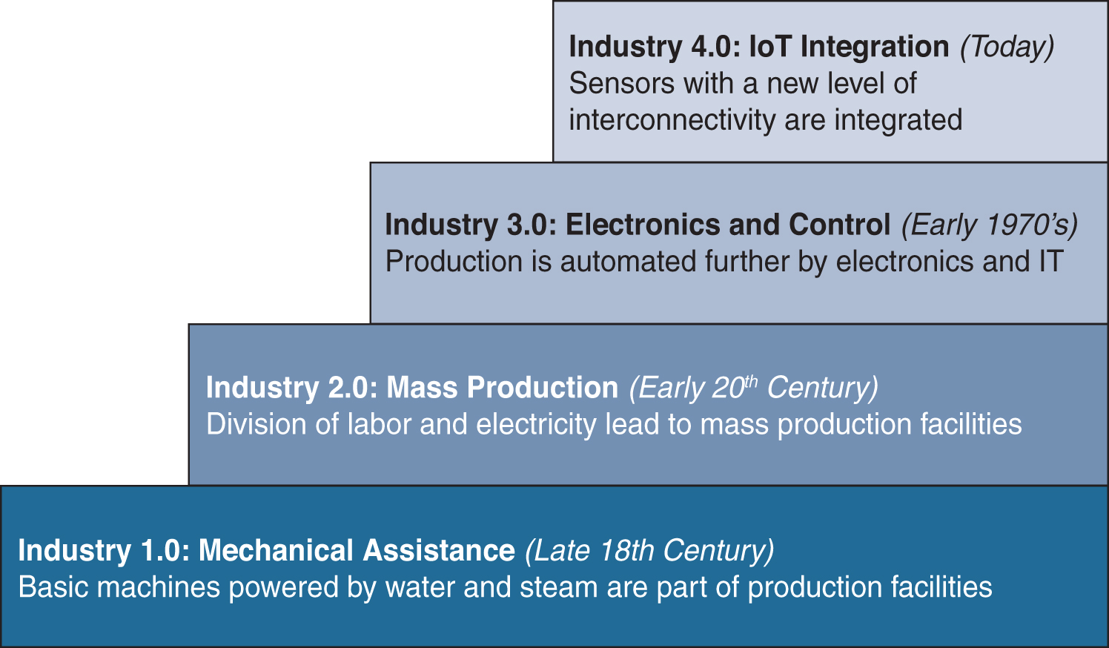
INTERNET OF THINGS
Connected Factory
Figure - The Four Industrial Revolutions

Slide 10
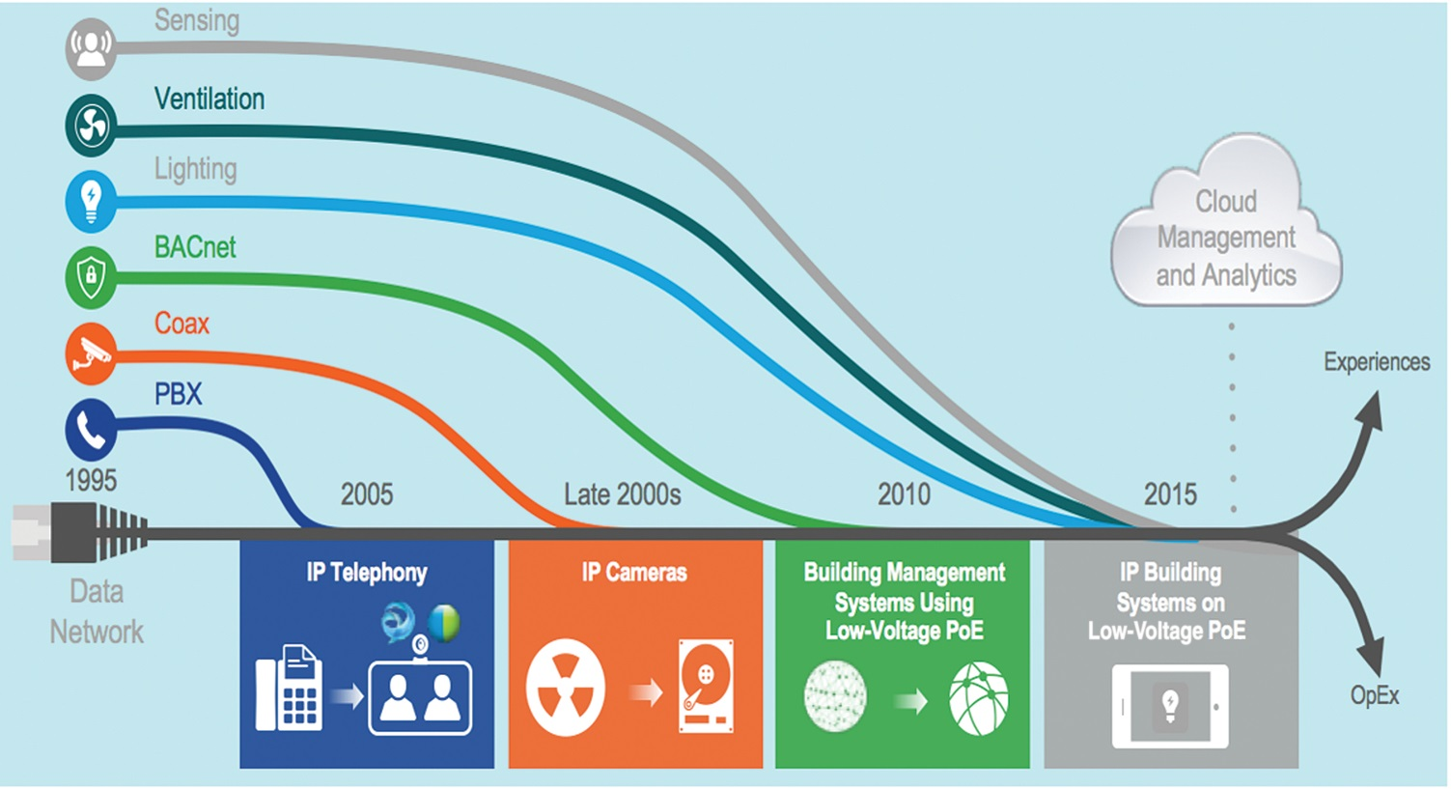
Smart Connected Buildings
INTERNET OF THINGS
Figure - Convergence of Building Technologies to IP

Slide 11
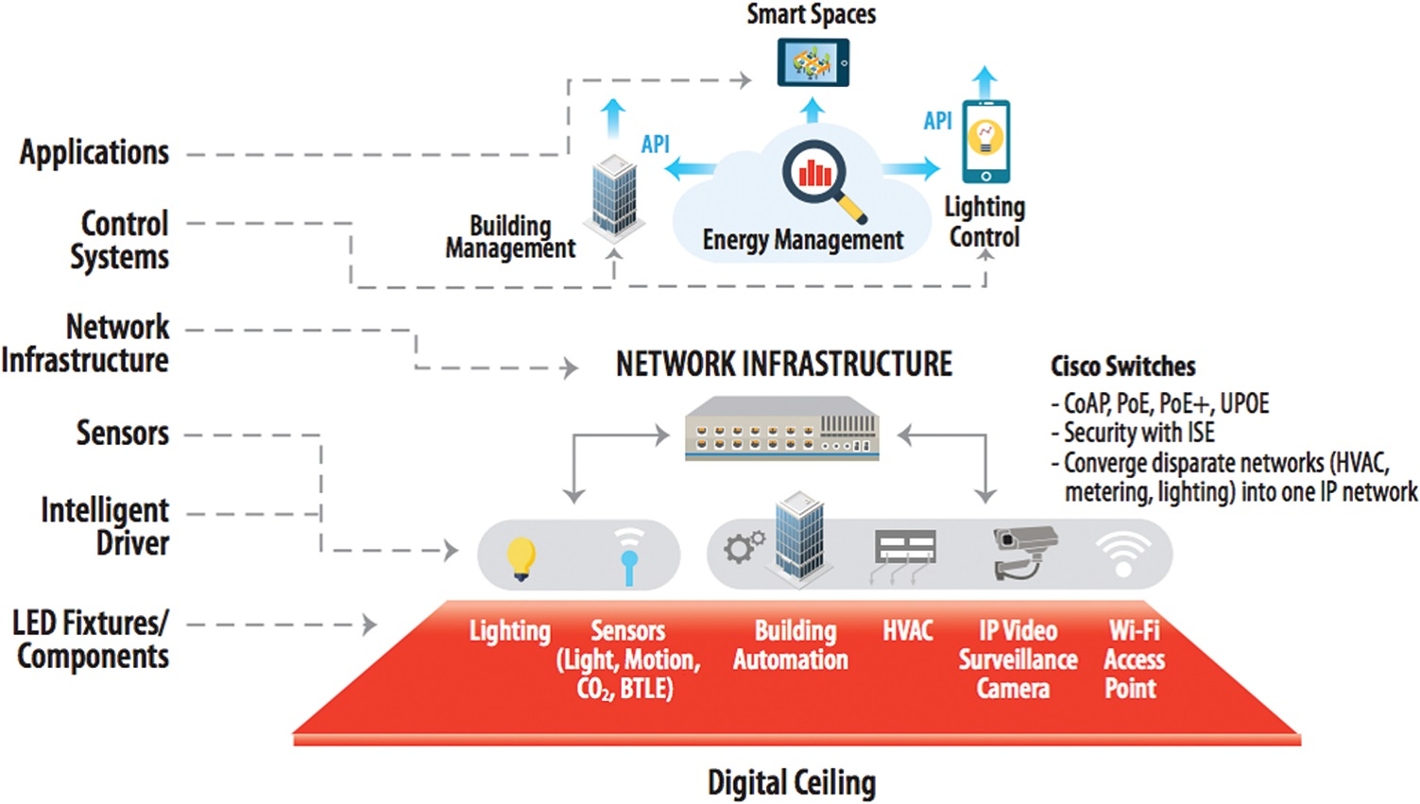
Smart Connected Buildings
INTERNET OF THINGS
Figure - A Framework for the Digital Ceiling

Slide 12
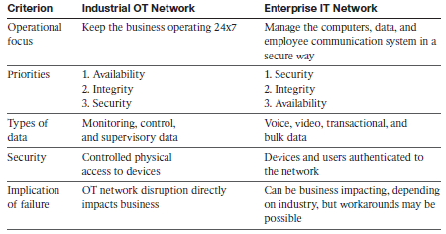
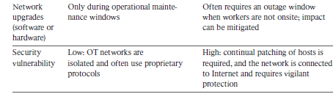
Convergence of IT and OT
INTERNET OF THINGS

Slide 13
IoT Challenges
INTERNET OF THINGS
Scale
Security
Privacy
Big data and data Analytics
Interoperability

Slide 14
THANK YOU
Dr. Nagegowda K S
Department of Computer Science & Engineering
nagegowda@pes.edu

